Slide 1
ATM management system
Presented by: engr. muhammad mansoor

Slide 2
Problem statement
The current ATM management system has several issues such as long queues, slow processing, frequent downtime, and limited functionalities. These issues have resulted in poor customer experience and loss of business for the banks.
The goal of this project is to develop a new ATM management system that addresses these issues and provides an improved customer experience. The system should be able to handle a large number of transactions quickly and efficiently, provide a wide range of functionalities, and ensure high uptime and availability.
The system should also include features such as advanced security measures to prevent fraudulent activities, user-friendly interfaces to ensure ease of use for customers, and real-time monitoring to enable quick response to any issues.
The project will involve designing and developing the new system, integrating it with the existing banking systems, and ensuring its seamless operation. The system should also be scalable and adaptable to accommodate future changes and advancements in technology.

Slide 3
Scope of work:
Release I Selection of Functionalities | Release II Selection of User Stories | Release III Implementation of selected functionalities using assigned tools | Release IV Selection of Test cases and their implementation.

Slide 4
Project Structure:
S.No | Roles | Name
1 | Engagement Manager | Jawad Naeem
2 | Project Manager | Muhammad Ateeb
3 | Software Engineer | Muhammad Mansoor
4 | Environment | Contour Software

Slide 5
Stake Holders (primary):
Sr. | Primary
1 | Project Manager
2 | Business Analyst
3 | Developers
4 | Quality Assurance Engineers
5 | UI Designers
6 | UX Designers
7 | INTERNET

Slide 6
Stake Holders (Secondary):
Sr. | Secondary
1 | Customers
2 | Banks
3 | State Bank of Pakistan
4 | Ministry of Finance
5 | Cybersecurity Wings
6 | Card Merchants
7 | Other Fintech Application Providers

Slide 7
Functionalities:
Sr. No | Functionality | Sub Functionality
1 | Authentication with Login | Card along pin is verified. Biometric Recognition with pin is supported.
2 | Cash Withdrawal | Cash Withdrawal with assigned limits Free of Cost at same bank ATM With Charges at different bank ATM
3 | Balance Inquiry | Free of Cost At same bank’s ATM With Charges at a different bank ATM
4 | Cash Deposit | Cash Deposit with assigned limits Free of Cost at same banks ATMS

Slide 8
Functionalities (Cont)
Sr. No | Functionality | Sub-Functionality
5 | Update Pin | Pin can be updated on same banks ATM
6 | Maintains Transaction Records | Transaction Records for each customer are maintained
7 | Bill payments | Bill Payments for Electricity, Gas , Water Telephone etc
8 | Funds Transfer to other Accounts | Funds Transfer to other accounts within the bank

Slide 9
User Stories:
Story ID | As | Wants to | So that they can
UT-01 | Customer | Log in to ATM using card | Perform a transaction
UT-02 | Customer | Check balance | To view their current available balance
UT-03 | Customer | Withdraw Cash | Fulfil their needs with directly going to bank 'counter.
UT-04 | Customer | Deposit Cash | So amount can be deposited in bank account without specifically going to bank’s counter
UT-05 | Customer | Update Pin | Replace their previous insecure pin with a new one in a hassle free way.

Slide 10
User Stories (Cont):
Story ID | As | Wants to | So that they can
UT-06 | Customer | Pay bills | Avoid long queues
UT-07 | Customer | Transfer funds within same bank | Transfer funds to other bank accounts within the same bank and avoid counters and deposit slip issues.
UT-08 | Customer | Transfer funds to other bank | Transfer funds to other bank accounts and avoid counters and deposit slip issues.
UT-09 | Customer | Login using biometric and pin | Avoid debit cards.
UT-10 | Customer | Needs mini bank statement | View their transaction history

Slide 11
Implemented functionalities:
Login with credentials
Balance inquiry at Same Bank’s ATM
Cash Withdrawal at same Bank’s ATM
Cash Deposit at same Branch
Update Pin at same branch
Transaction List

Slide 12
Test cases:
Login with correct credentials(Card Number and Pin)
Login with incorrect credentials
Balance Check
Cash Withdrawal beyond limits
Cash withdrawal within limits
Cash Deposit Beyond Limits
Cash Deposit within limits
Update Pin by a new pin
Update Pin with existing pin
Implementing any of the test case without Login

Slide 13
Tools Used:
JAVA
MySQL
Spring Boot
JPA & Hibernate
Spring security
Swagger
Postman
REST API
Junit testing
IntelliJ Idea Ultimate
MySQL work bench
Thymleaf

Slide 14
Requirement Traceability matrix

Slide 15
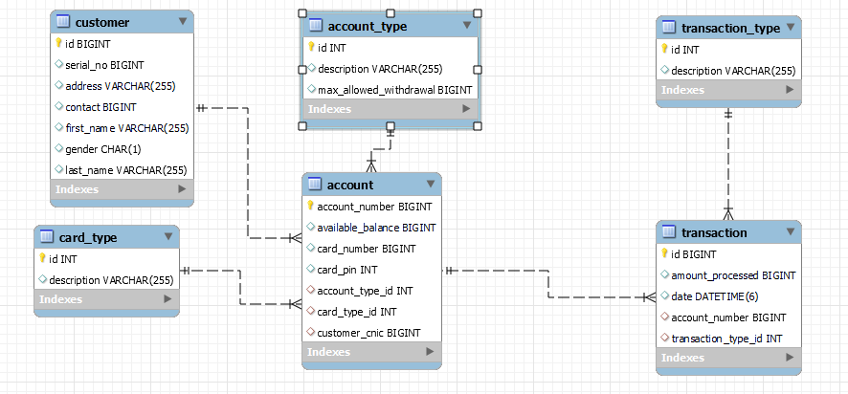
ERD Diagram for Relations:

Slide 16

Implementing Test Cases:

Slide 17

Wrong Credentials

Slide 18
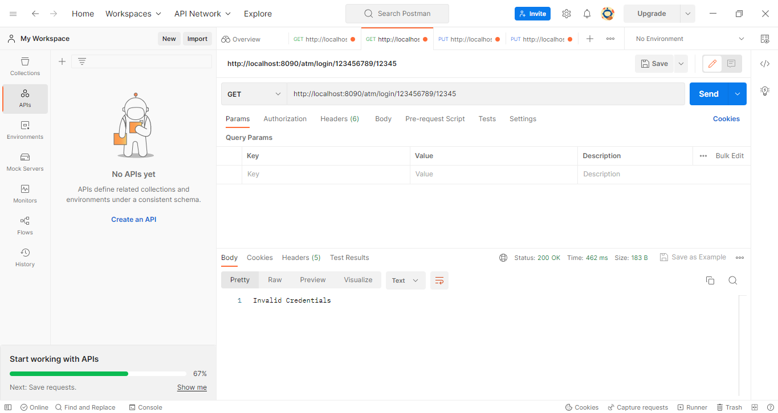

Slide 19
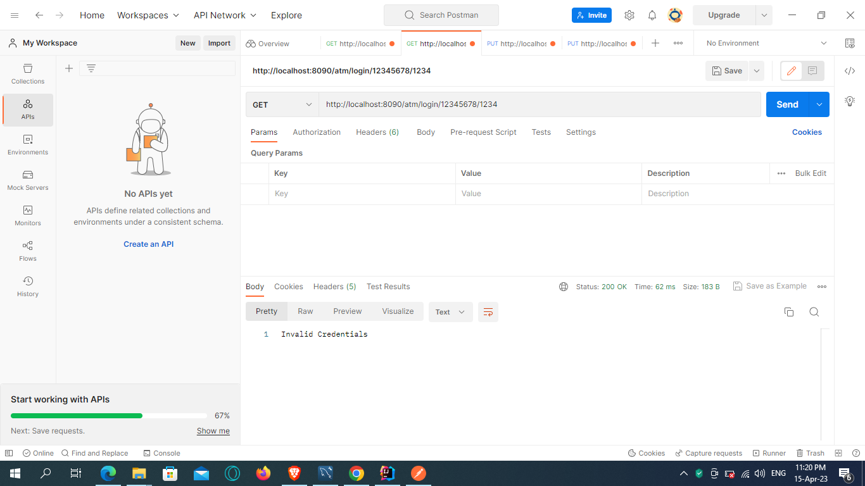

Slide 20

Balance inquiry

Slide 21


Slide 22

Exceeding Withdrawal Limit

Slide 23


Slide 24

Successful WithDraw

Slide 25
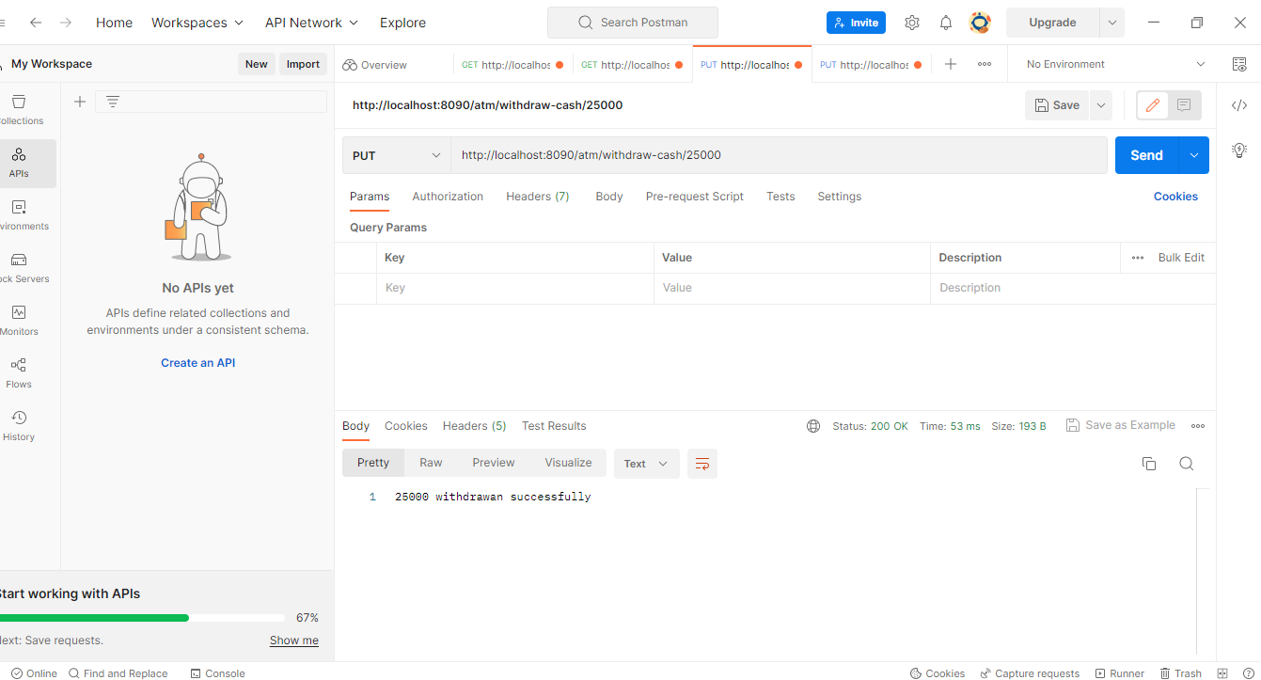

Slide 26

Transaction history In RDBMS

Slide 27
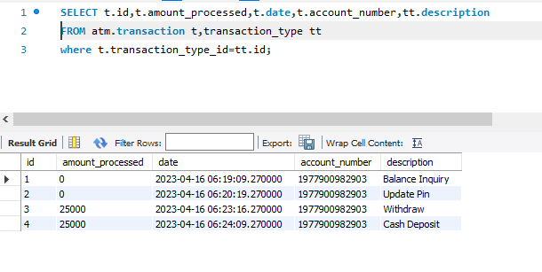

Slide 28
Out of scope:
Login with biometric
Balance inquiry at different bank’s ATM
Cash withdrawal at different bank’s ATM
Cash deposit at different bank’s atm
Update pin at different bank’s atm
Bill payments
Funds transfer to other accounts
Further implementation of spring security
Further implementation of frontend technologies

Slide 29
Future Work
All the out of scope functionalities.
Further Enhancements related to Security and Front-End

Slide 30


Slide 31
THANK YOU

